Slide 1


PROMPT DEFECT
A Prompt-Based Anomaly Detection System
VAND 3.0 Challenge MVTEC AD 2 Dataset Unsupervised Anomaly Detection and Localization in Industrial Products

Slide 2

ABOUT US
Muhammad Taha Mustafa 22K-8735
Saad Shuraim Rashid 22K-4108
Sharique Shah Lakhani 22K-8712
Arish khan 22K-4118

Slide 3
OBJECTIVE
Develop an unsupervised anomaly detection model using MVTEC AD 2.Identify and localize defects in industrial products. Model trained solely on normal images, evaluated on a mix of normal and anomalous images.

Slide 4

CHALLENGES
Real-World Variability: Handling diverse lighting, transparency, and overlapping objects.
Extremely Small Defects: Detecting subtle anomalies occupying small regions.
Unsupervised Learning: Learning from normal images without any prior defect information.

Slide 5
Pixel-Level Localization: Accurate segmentation of defective regions.
Robustness Assessment: Ensuring performance across varied test scenarios.

Slide 6
EVALUATION METRICS
Segmentation F1 Score (SegF1): Balance between precision and recall in pixel-level anomaly detection.
Image AUC : For global image anomaly detection.

Slide 7
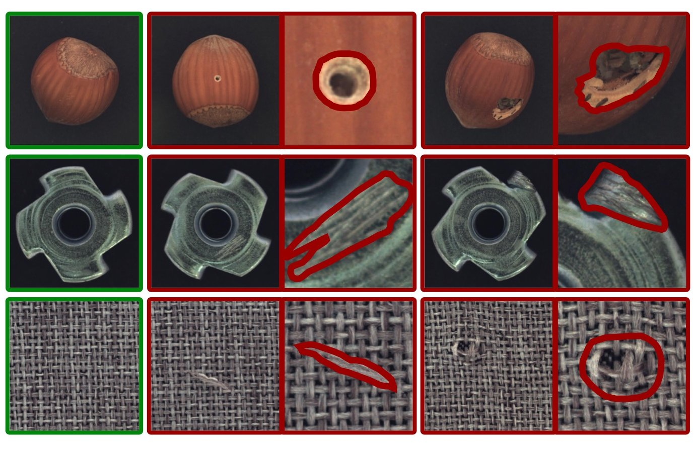
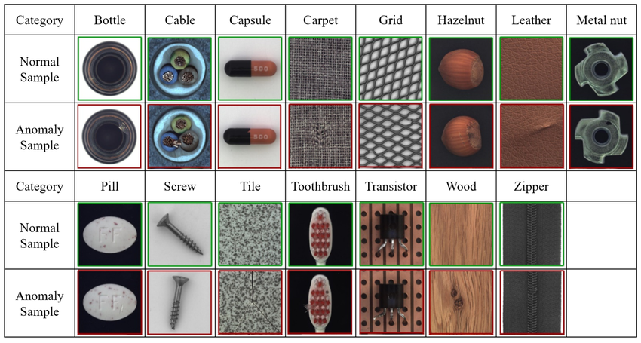
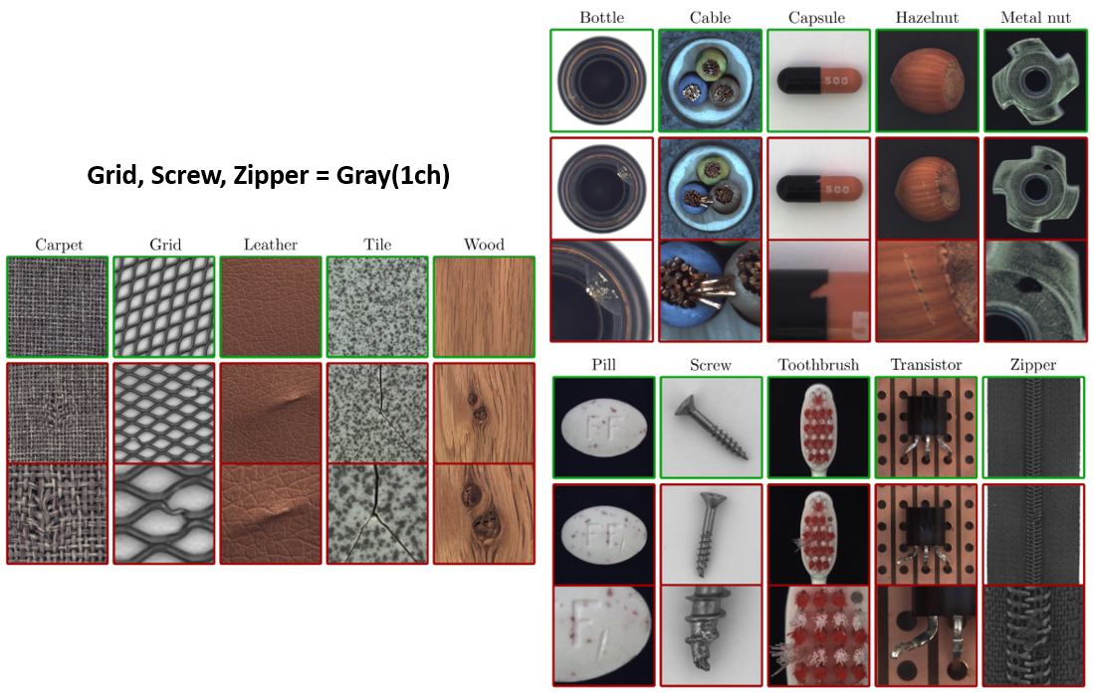
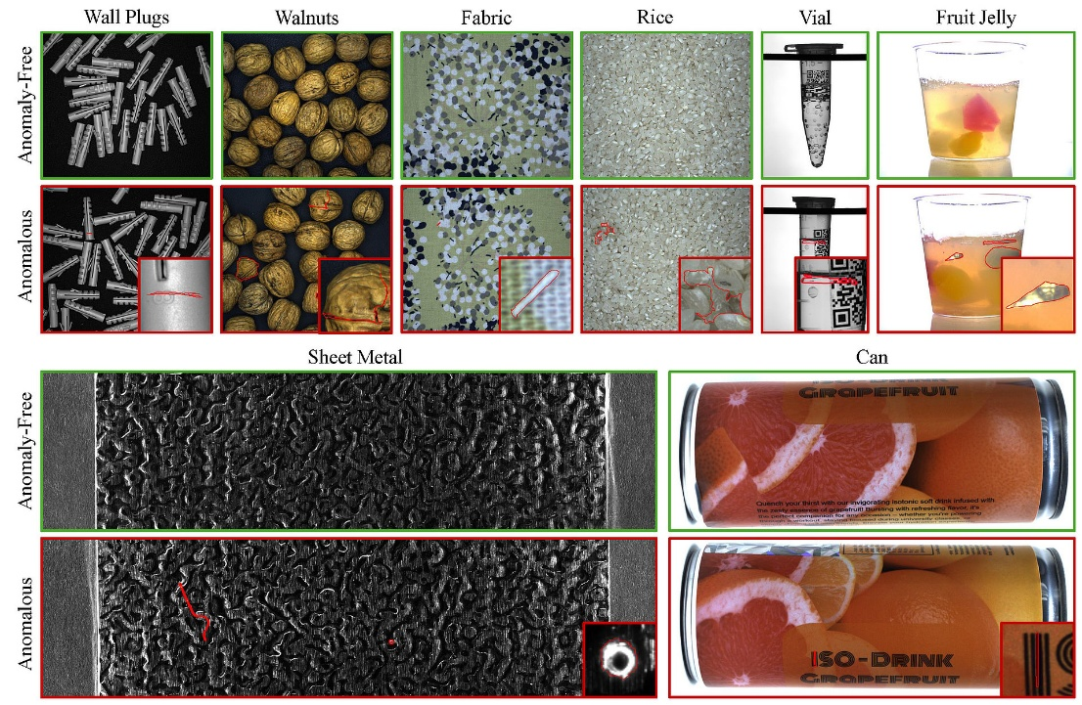
DATASET OVERVIEW

Slide 8
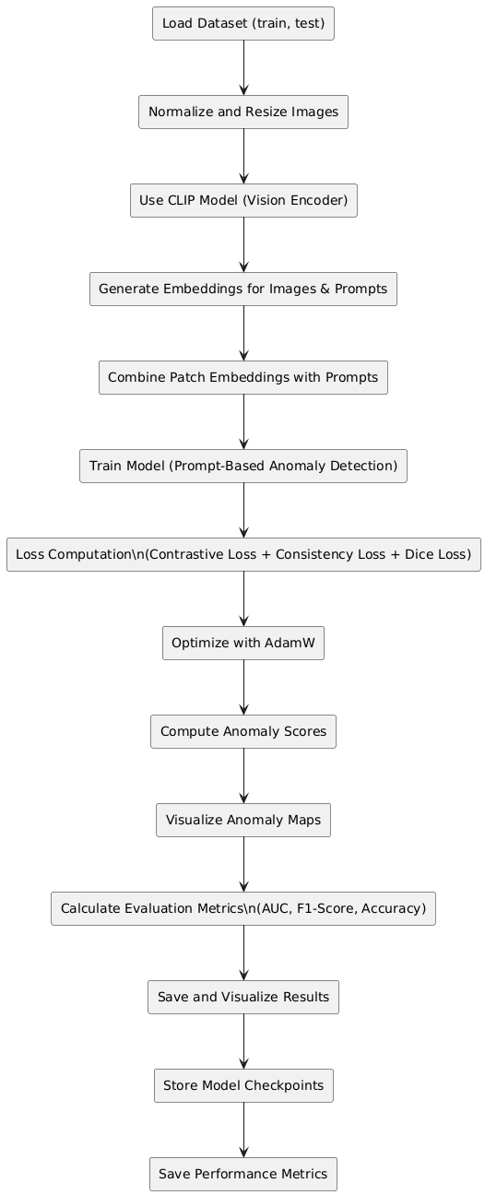
OUR APPROACH

Slide 9
INNOVATION

Slide 10
RESULTS

Slide 11

FINDINGS

Slide 12
Arowwai Industries
THANK YOU!
FOR YOUR ATTENTION
www.reallygreatsite.com

